Slide 1

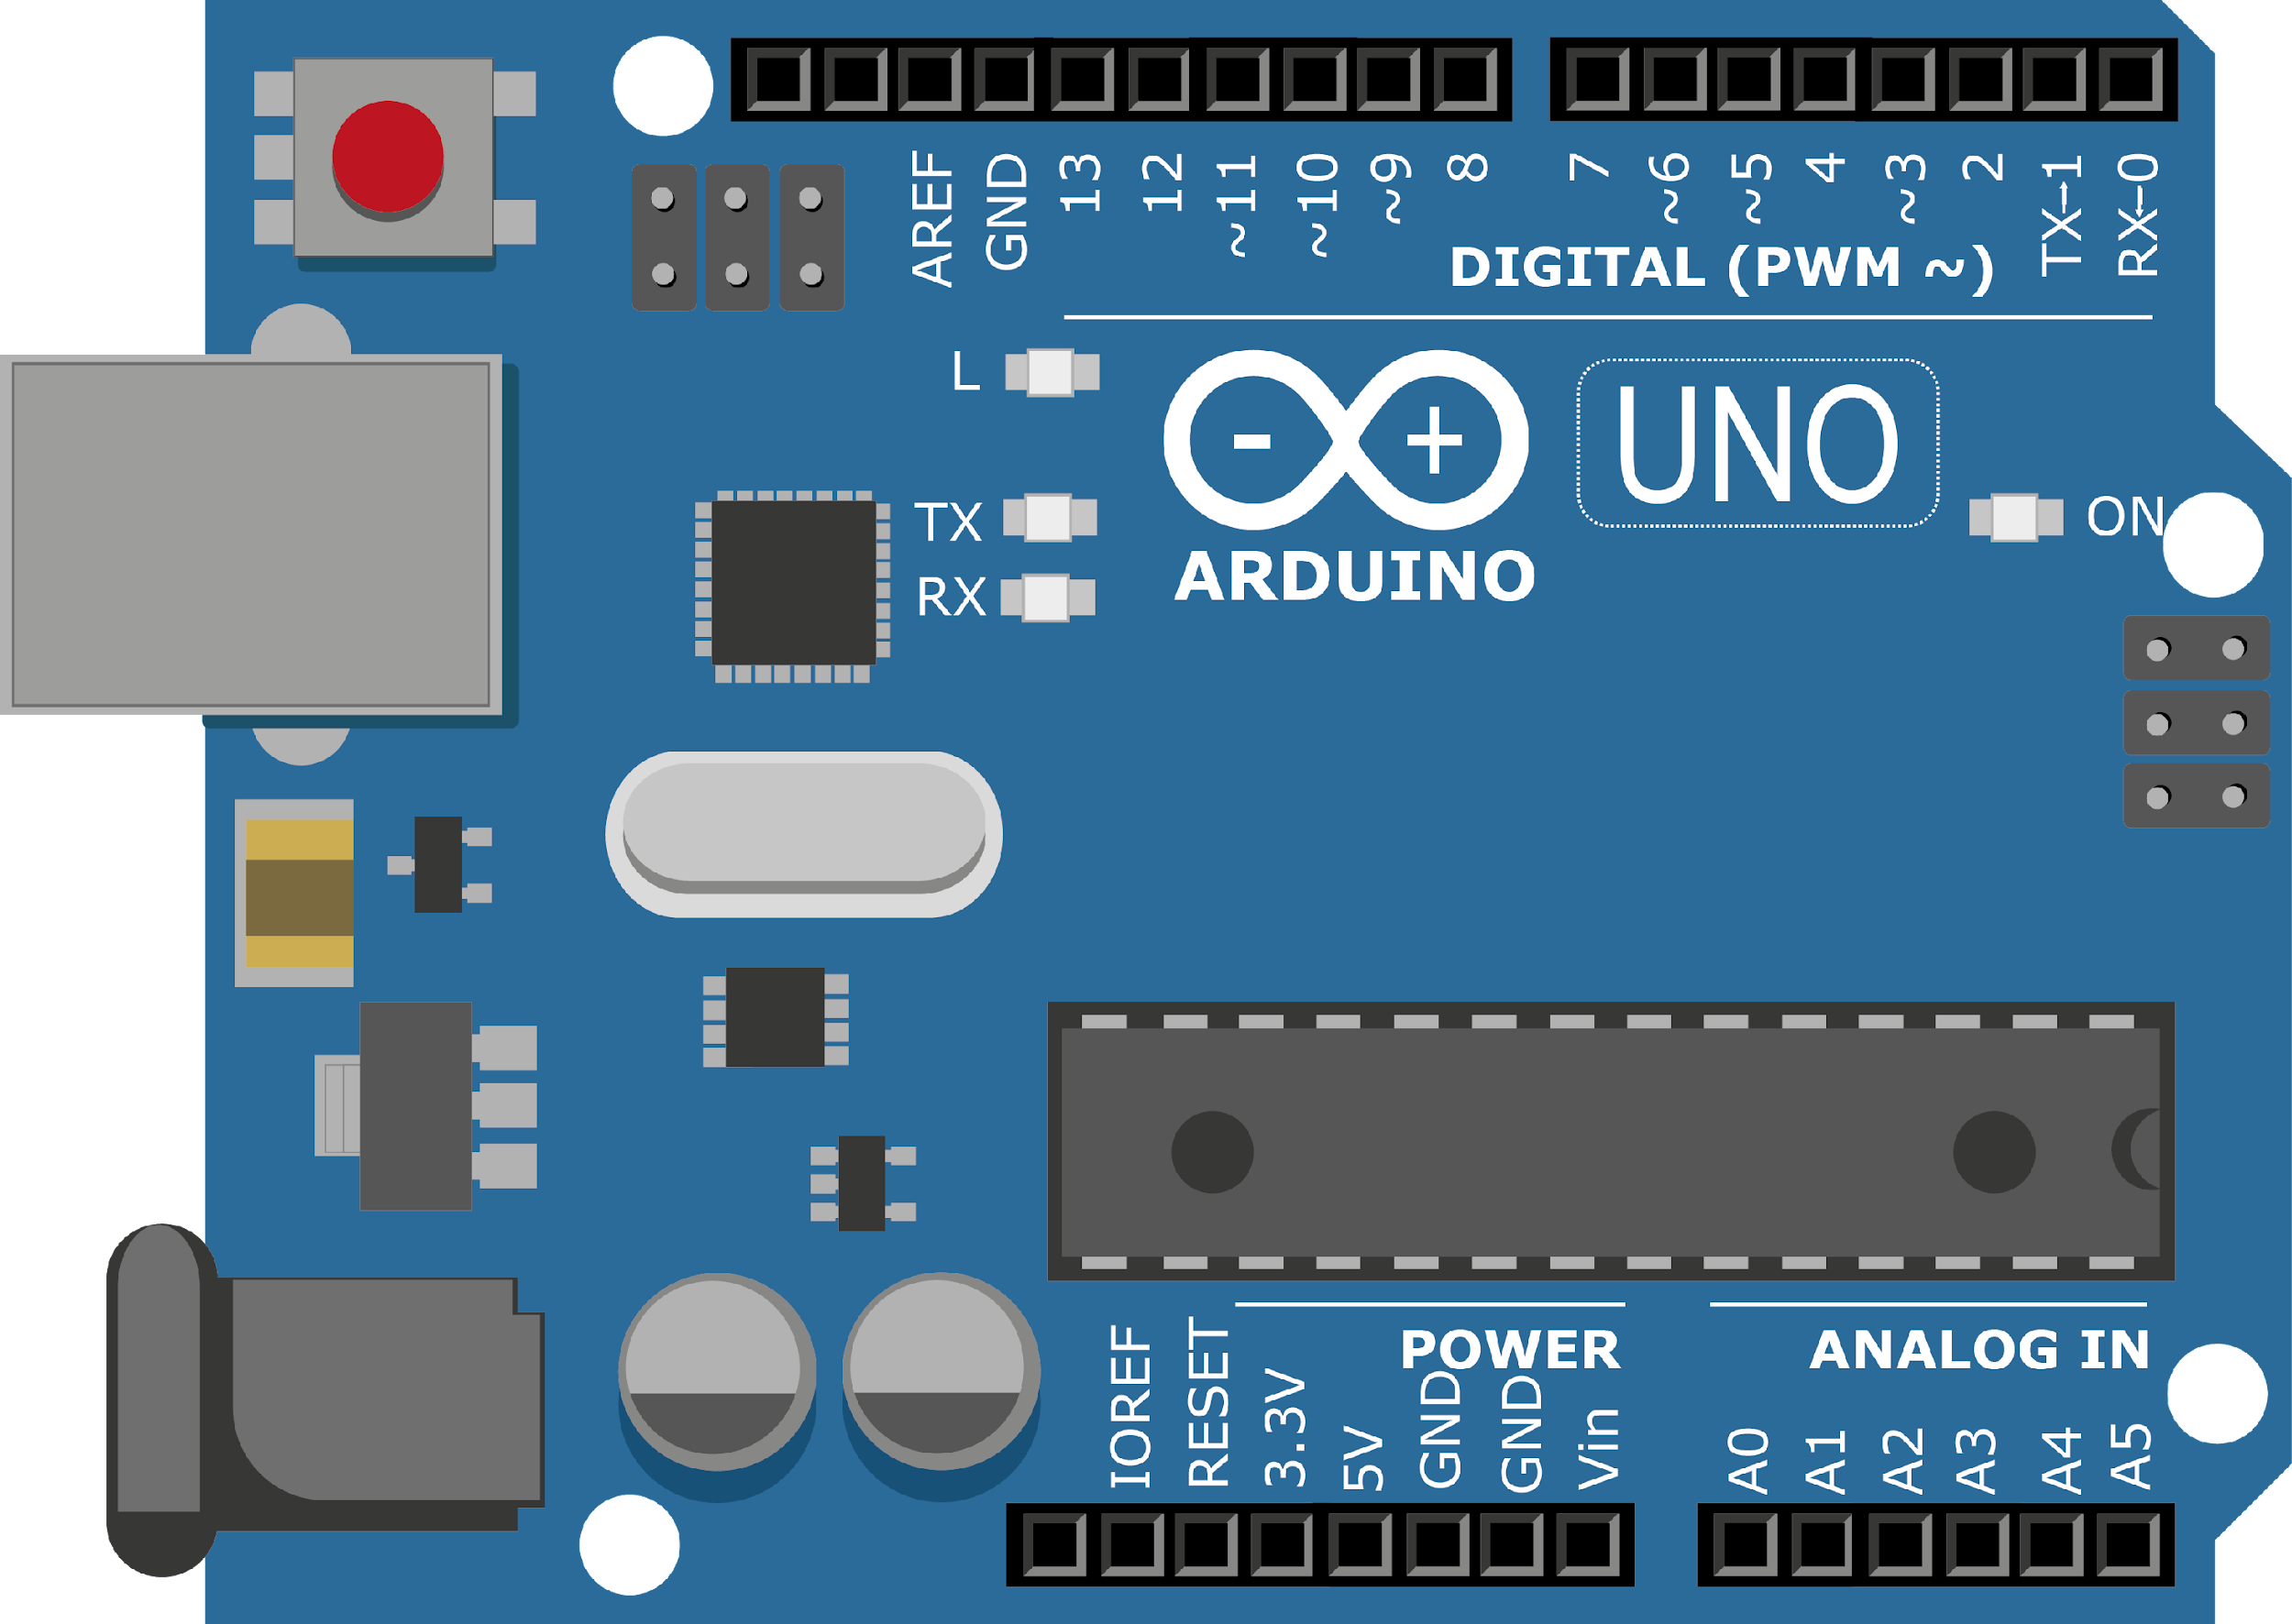
ARDUINO MASTER CLASS
22
LCD Interface

Slide 2
22 AGENDA
02
03
01
Interface with Arduino
Arduino Simulator
LCD

Slide 3
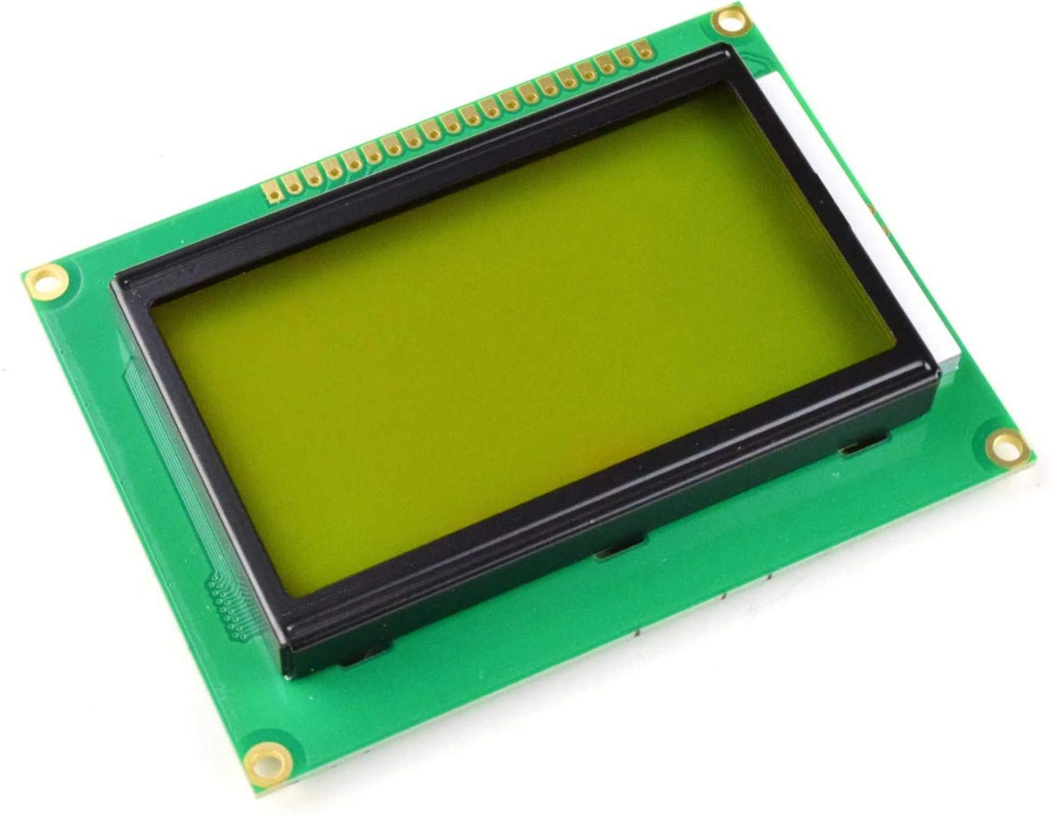
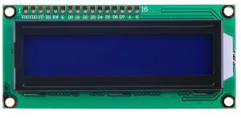
LCD - Liquid Crystal Display
It is a type of flat panel display which uses liquid crystals in its primary form of operation.
16×2 character LCD
GLCD

Slide 4
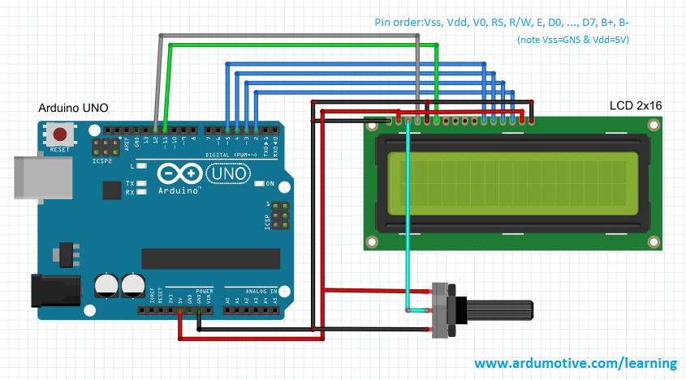
16x2 LCD with Arduino

Slide 5

Arduino Simulator

Slide 6
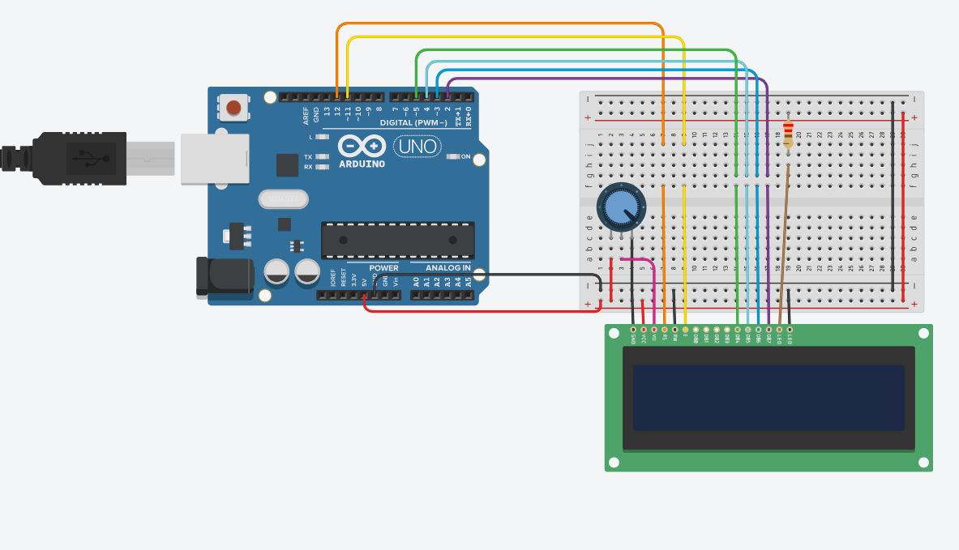
Arduino LCD - Autodesk

Slide 7
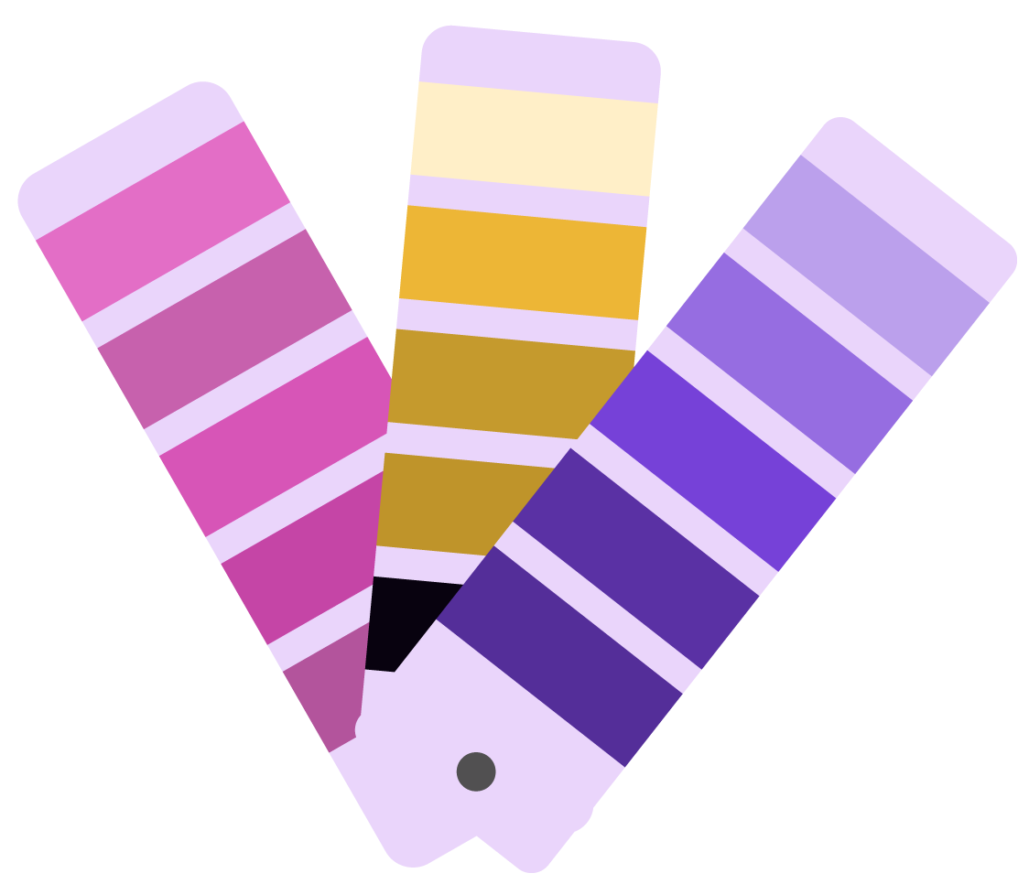
INTERVIEW QUESTIONS
Decoupling capacitor
Pullup & Pulldown
CISC vs RISC
Reduced Instruction Set Computer Processor - simple collection and highly customized set of instructions | each instruction cycle requires only one clock cycle, and each cycle contains three parameters: fetch, decode and execute.
Complex Instruction Set Computer - CISC approaches reducing the number of instruction on each program and ignoring the number of cycles per instruction. CISC chips are relatively slower as compared to RISC chips but use little instruction than RISC.
If the input voltage drops, then a decoupling capacitor will be able to provide enough power to an IC to keep the voltage stable.
If the voltage increases, then a decoupling capacitor will be able to absorb the excess energy trying to flow through to the IC, which again keeps the voltage stable.
A pull-up resistor connects unused input pins (AND and NAND gates) to the dc supply voltage, (Vcc) to keep the given input HIGH. A pull-down resistor connects unused input pins (OR and NOR gates) to ground, (0V) to keep the given input LOW.

Slide 8
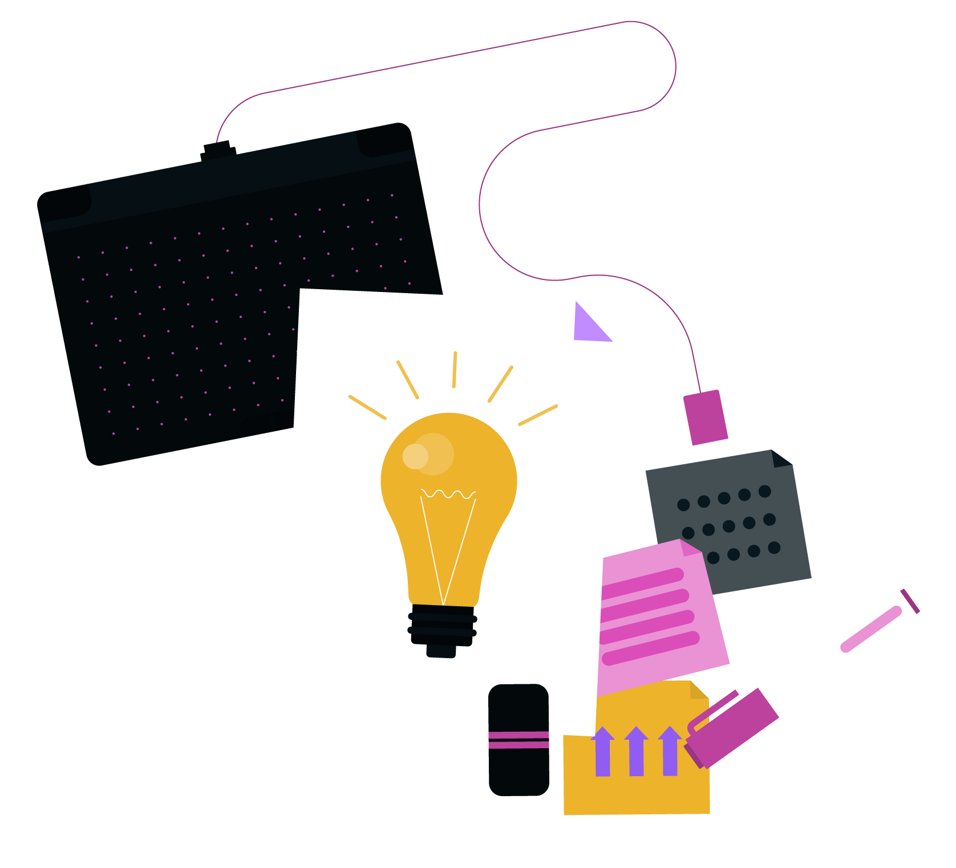
THANKS!

